Slide 1
Conclusion to Microsoft Azure for Research Training!
Microsoft Research
Microsoft Azure for Research Training

Slide 2
Microsoft Azure for Research
Learning objectives – what you have learned from the class:
An understanding of cloud computing
Why and when you would use it in scientific or other research
Hands-on experience in major patterns for successful cloud applications
Skills to run your own applications/services on Microsoft Azure
Ultimately: researchers will feel confident in applying cloud computing in their current and future research

Slide 3
Next Steps
Use Microsoft Azure! Use your Training Pass for the next 180 days! https://manage.windowsazure.com/
Apply for a Research Award from Microsoft Research http://www.windowsazurepass.com/research
More information on Microsoft Azure for Research http://azure4research.com (more research-specific resources coming)
Join the community http://www.windowsazure.com/en-us/support/forums/ (research and non-research)
Other resources, including full documentation, curriculum materials, etc. http://azure.microsoft.com

Slide 4
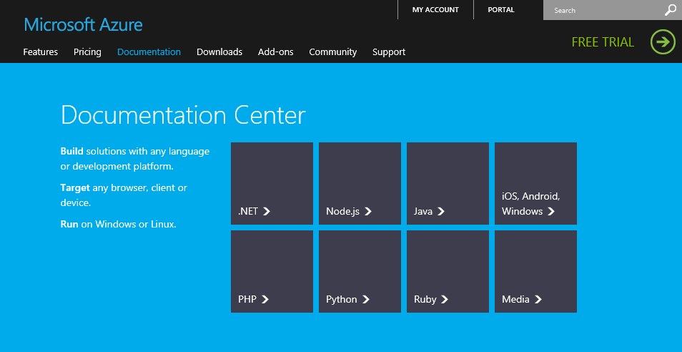
Next Steps (Continued)
Microsoft Azure Training Kit For developers!
http://www.windowsazure.com/en-us/develop/net/other-resources/training-kit/
More on Architecture, Reference, Best Practice, Code samples on WindowsAzure.com Developer Center.

Slide 5
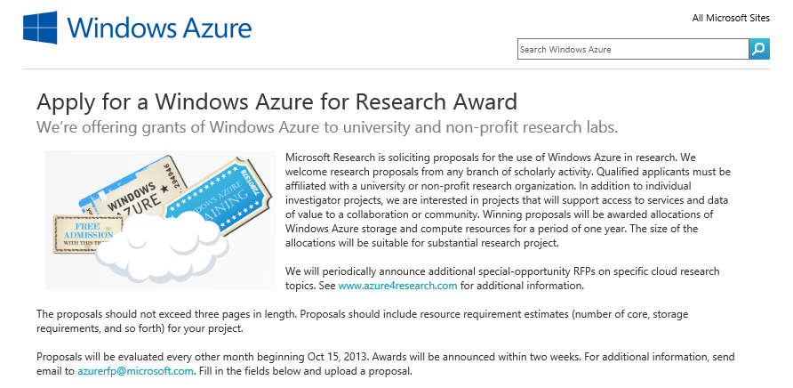
Microsoft Azure Research Awards
2-month recurring RFP
3-page max proposal
Compelling research
State Azure needs
Training helps!
Awards: 1 year Research Pass (worth up to $40,000)
http://www.windowsazurepass.com/research

Slide 6
More training
For you, your colleagues, your students, your contacts…
Academic Research http://research.microsoft.com/en-us/projects/azure/training.aspx
Academic Teaching http://www.microsoft.com/education/facultyconnection/WinAzure.aspx http://www.windowsazure.com/en-us/community/education/
Everyone - Microsoft Developer Camps http://www.microsoft.com/enterprise/events/make-it-happen

Slide 7



Microsoft Azure for Research
Accelerate the Speed of Scientific Discovery
Microsoft Azure provides researchers with the power and scalability of cloud computing for collaboration, computation, and data-intensive processing. This open and flexible global cloud platform supports any language, tool, or framework.
The Microsoft Azure for Research program:
· Free access to Microsoft Azure cloud computing and storage
(submit proposals for Microsoft Azure Research Awards)
· Microsoft Azure for Research training classes
· Support and technical resources
Apply the power of cloud computing to your computational and data challenges. Experiment at azure4research.com.
Notes:
What MSR is doing

Slide 8
http://azure4research.com
Microsoft Research
Microsoft Azure for Research
Notes:
By default, send people here – URL for the previous slide

Slide 9
Course evaluation survey

Slide 10
Any final questions? azuretraining@microsoft.com

Slide 11
Goodbye! Have a safe trip home!
Microsoft Research
Microsoft Azure for Research Training

